Slide 1





Presentation Topic:
Rock, Paper, Scissors game using Artificial Intelligence in Python.

Slide 2

SUBMITTED BY
Fahim chowdhury
ID:2215151127
Sadia ahmed mou
ID:2215151145
Jarin Jubuyer jui
ID:2215151141
Submitted to:
Ratri Datta
lecturer
Department of CSE,UITS
Submitted to:
Fatema Tuj Tarannom Esty
lecturer
Department of CSE,UITS

Slide 3

Contents:
Introduction
Background Study
Objectives
Features
Demonstration
Functionality
Characteristics

Slide 4
INTRODUCTION
In this presentation, we'll explore the classic game of Rock, Paper, Scissors (RPS) as a surprisingly insightful playground for Artificial Intelligence (AI). We'll see how this simple game can be used to introduce core AI concepts and demonstrate how AI can learn and adapt.

Slide 5
Background study:
RPS serves as a basic example of a zero-sum game, where one player's win directly translates to the other's loss.
Understanding optimal strategies and decision-making processes in RPS helps develop AI for more complex games and competitive environments.
RPS provides a controlled environment to benchmark and compare different AI algorithms.
By measuring win rates and strategic decision-making, researchers can evaluate the effectiveness of various AI approaches.

Slide 6

OBJECTIVE:
• Making a game to play with the computer's random values
• Use an algorithm that matches my answer with the computer's answer and can show the winning result
We'll explore how to apply basic AI concepts like [mention concepts] to create an intelligent and engaging opponen
Additionally, we'll delve into the Python code used to build the game's functionalities.

Slide 7



Features
Build in functions in Python
Algorithm to find and match the final results.
random values

Slide 8

Functionality
The program allows the user to play multiple rounds of Rock, Paper, Scissors against a computer opponent. The computer randomly selects its choice each round. The user enters their selection numerically (1 for Rock, 2 for Paper, 3 for Scissors).

Slide 9


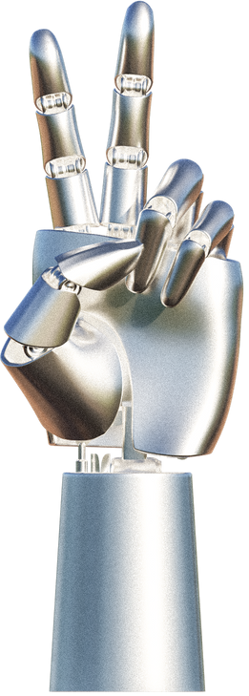
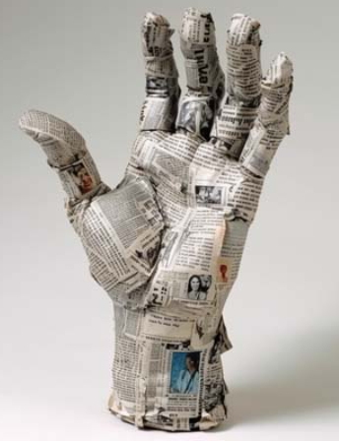
The program determines the winner based on the classic rules:
Rock crushes Scissors
Paper covers Rock
Scissors cut Paper
Identical selections result in a draw

Slide 10


The program keeps track of the user's score and the computer's score for five rounds. Finally, it displays the overall winner (user or computer) or a draw if the scores are tied.

Slide 11





DEMONSTRATION

Slide 12

Characteristics :
Easy to understand
Beginner Friendly Project
Using Simple AI tools

Slide 13


CONCLUSION
This program demonstrates a basic implementation of Rock, Paper, Scissors with a random AI opponent. While it serves as a good starting point for understanding game development and user interaction, it lacks a true AI element. The suggested enhancements could elevate the program by introducing a more strategic AI and additional gameplay options.

Slide 14

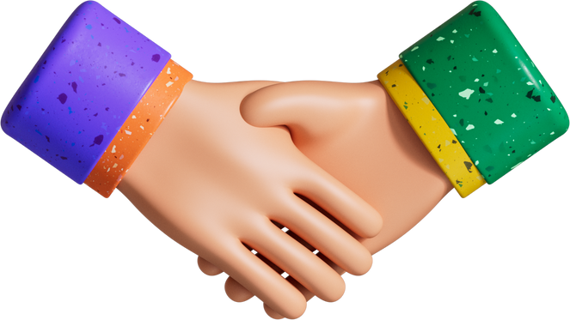
THANKS FOR BEING WITH US...

